Slide 1
Investment opportunities at the heart of Europe’s fastest growing region
INVESTMENTS OF € 20 BILLION

Slide 2

Swedish government is putting focus on investment promotive work
New addition to the Swedish Export Strategy with focus on foreign investments.
Foreign investments contribute to economic growth and increased employment.
Increased competition forces increased productivity also in the domestic market.
Co-operations with foreign companies increases level of knowledge and innovation.
20% of Swedish private workforce is employed by foreign-owned companies.
50% of Swedish export originates from foreign-owned companies.
Foreign-owned companies is behind 36% of total private R&D spending in Sweden, 28 billion SEK.
The competition for foreign investments are harsh – but it is a successful long-term strategy.

Slide 3
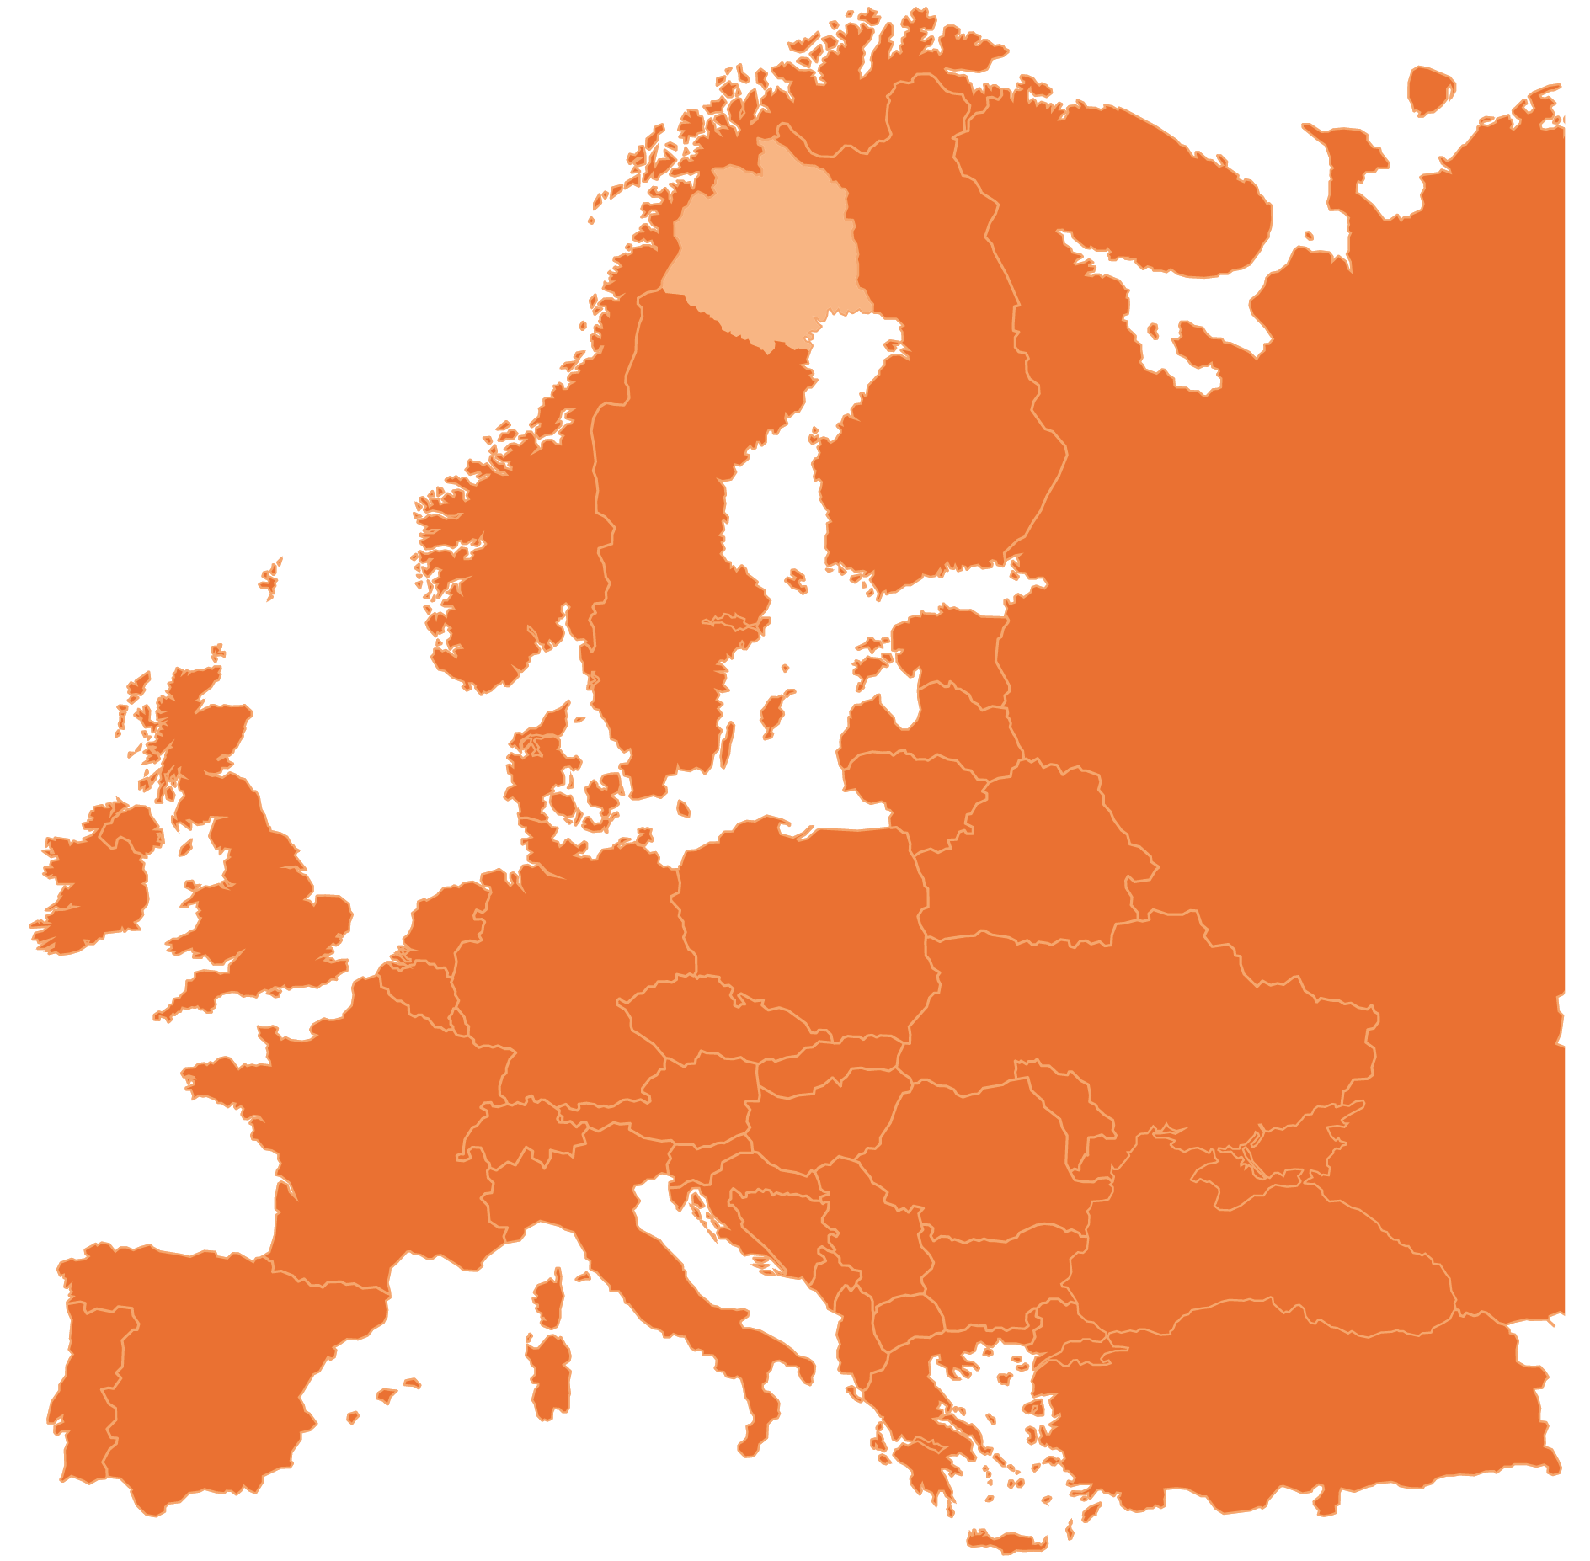
Our region
Norrbotten County – northernmost in Sweden
Surplus in power production
Stable power grid
Power intensive industries
Excellent logistics and communications
A population of approx. 200,000
Lot of investments done and planned
Socially and politically stable

Slide 4
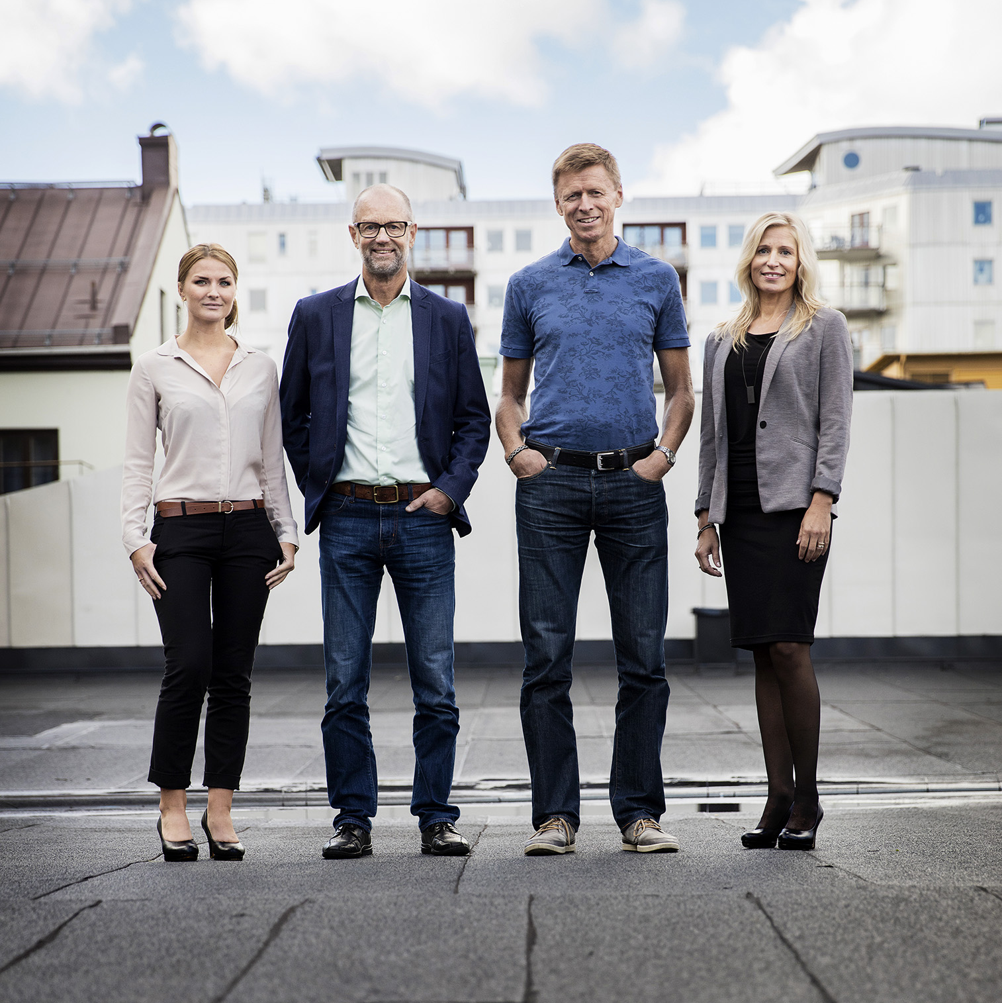
Our mission
Invest in Norrbotten attracts new businesses and investment to Sweden’s northernmost region by using our unique knowledge of the regions offer and our extensive international network.
Registered company owned by Norrbottens Läns Landsting and the municipalities of Norrbotten.
Supporting 14 municipalities in the region.
Regional, and foreign direct, investment support
Foreign partner investment support and site development
Close collaboration as regional partner to Business Sweden
Assigned task by owners through strategic plan for new investments:
Creating international network
Learning process
Developing business areas with regional partners

Slide 5
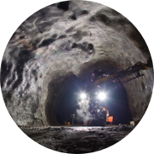
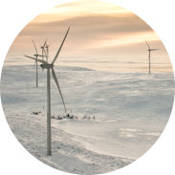
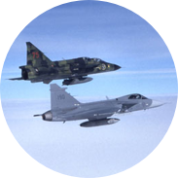
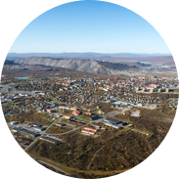

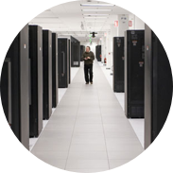
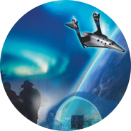
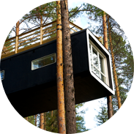
Our investment areas
Previous and planned investments in the region have a net worth of €20 billion – a trend that are expected to continue in the future.
MINING AND STEEL
ENERGY
COLD CLIMATE TESTING
URBAN TRANSFORMATION & EXPANSION
BIOECONOMY
DATACENTER
SPACE
TOURISM INDUSTRY
Notes:
Mining and steel: 90% of Europe's iron ore production. Unique R&D facilities in metallurgy.
Bioeconomy: Large forest and bio refinery industry. Module Housing factories.
Energy: Major part of Sweden’s hydropower generation – all renewable. Permission granted for 350 new wind turbines.
Datacenter: Investments made by Facebook and Hydro 66. The Node Pole as regional developer for new sites.
Cold climate testing: Long history of car testing in the region. Also cold-climate testing for military, airplanes, trains etc.
Space: Esrange Space Center and Spaceport Sweden as a base for Swedish space research.
Urban transformation and expansion: City-relocations in Kiruna and Gällivare. Growing cities with high demands on new housing. Sustainable cities.
Tourism Industry: Fastest growing in Sweden with large export value. Home of Treehotel and Icehotel.

Slide 6
Kapitel x
Investment opportunities at the heart of Europe’s fastest growing region

Slide 7
Kapitel x
Investment opportunities at the heart of Europe’s fastest growing region

Slide 8
Kapitel x
Investment opportunities at the heart of Europe’s fastest growing region

Slide 9
Kapitel x
Investment opportunities at the heart of Europe’s fastest growing region

Slide 10
Our investment areas
Previous and planned investments in the region have a net worth of €20 billion – a trend that are expected to continue in the future.
Mining and steel: 90% of Europe's iron ore production. Unique R&D facilities in metallurgy.
Energy: Major part of Sweden’s hydropower generation – all renewable. Permission granted for 350 new wind turbines.
Urban transformation and expansion: City-relocations in Kiruna and Gällivare. Growing cities with high demands on new housing. Sustainable cities.
Bioeconomy: Large forest and bio refinery industry. Module Housing factories.
Cold climate testing: Long history of car testing in the region. Also cold-climate testing for military, airplanes, trains etc.
Tourism Industry: Fastest growing in Sweden with large export value. Home of Treehotel and Icehotel.
Datacenter: Investments made by Facebook and Hydro 66. The Node Pole as regional developer for new sites.
Space: Esrange Space Center and Spaceport Sweden as a base for Swedish space research.

Slide 11
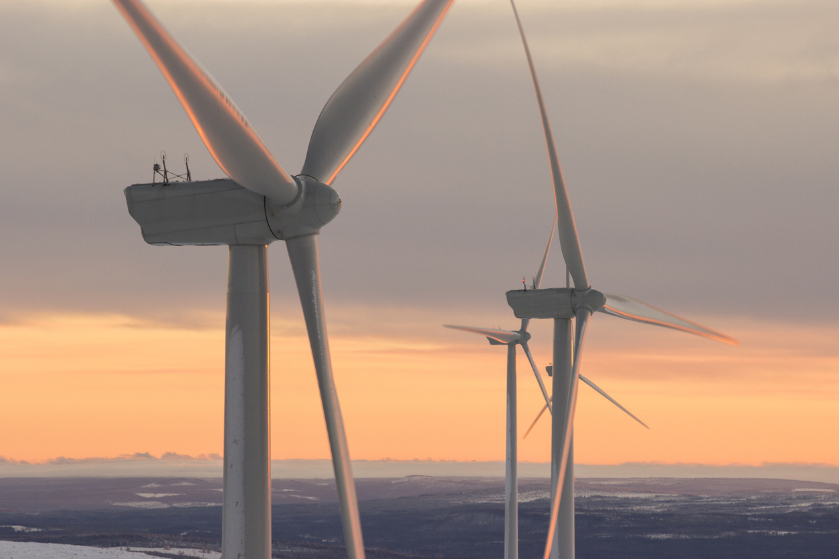
Our advantages
Europe’s lowest energy prices
100 % renewable energy
Regional industrial eco-system
Prominent clusters in several business areas
Ready-to-build sites for new developments
Luleå University of Technology
Research & Development
Infrastructure
Distinguished competence and talents
Notes:
The Arctic region is more attractive than ever. In Norrbotten we have proven that we have the ability to make the most out of our natural recourses creating sustainable businesses.
Europe’s lowest energy prices and redundant power grid with extreme dependability.
100 % renewable energy.
Regional industrial eco-system with proven capacity to deliver.
Prominent clusters in several business areas with close collaborations.
Ready-to-build sites for new developments.
Luleå University on Technology: innovation in renewable energy, mining, sustainable transportation, ICT, Intelligent Industry processes, smart machines and materials etc.
Research & development collaboration with businesses and academia.
Infrastructure: Major ports, 4 airports, primary rail routs, primary road routes.
Distinguished competence and talents.

Slide 12
Our advantages
The Arctic region is more attractive than ever. In Norrbotten we have proven that we have the ability to make the most out of our natural recourses creating sustainable businesses.
Europe’s lowest energy prices and redundant power grid.
100 % renewable energy.
Regional industrial eco-system with proven capacity to deliver.
Prominent clusters in several business areas with close collaborations.
Ready-to-build sites for new developments.
Luleå University on Technology: innovation in renewable energy, mining, sustainable transportation, ICT, Intelligent Industry processes, smart machines and materials etc.
Research & development collaboration with businesses and academia.
Infrastructure: Major ports, 4 airports, primary rail routs, primary road routes.
Distinguished competence and talents.

Slide 13
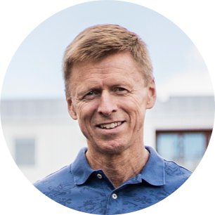
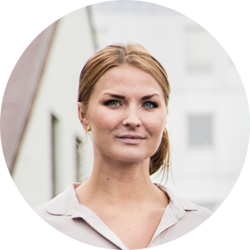
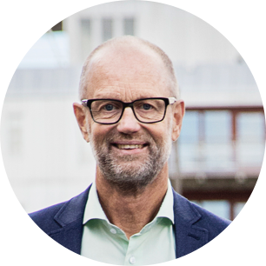
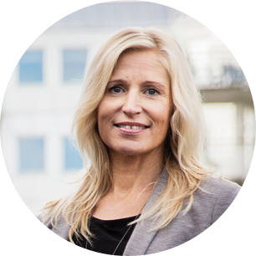
Get in touch
We are ready to tell you more about the opportunities in the region and happy to share our network and knowledge.
Jörgen Eriksson
CEO / Investment Director
jorgen@investinnorrbotten.se
Natalie Sidén
Investment Manager
natalie@investinnorrbotten.se
Göran Littorin
Investment Manager
goran@investinnorrbotten.se
Satu Norsten Manninen
Investment Manager
satu@investinnorrbotten.se

Slide 14
www.investinnorrbotten.se

